Slide 1
IOT BASED CHEMICAL DETECTION IN FRUITS AND VEGETABLES
Submitted By,
MINNU SAMUEL
S6 MCA
Reg No:LLMC16MCA020

Slide 2
01
Abstract
Agenda
02
Existing System
03
Proposed System
04
Block Diagram
05
Steps

Slide 3
06
Requirements
07
Hardware Requirements
Agenda
08
Software Requirements
09
Future Enhancement
10
Conclusion

Slide 4
ABSTRACT
Internet of Things (Iot) technology has been identified as one of the emerging technologies which is widely used in all walks of life in the world. It has a wide range of applications in agriculture and food industry.
By using IoT, we can monitor the fruits and vegetables and determine it is organic or not. With the help of a ph sensor and a gas sensor, we are detecting the chemical contents in each fruit and vegetable. The results should be stored in our computer, it can be analysed and we can select the fruit/vegetable that is harmless to our health.

Slide 5
EXISTING SYSTEM
Monitoring of chemicals in fruits and vegetable sample uses gas chromatography and liquid chromatography or its combination are the traditional analytical techniques for identification and quantity determination of chemical residues. Moreover, they are too complex and needs more human effort.
Drawbacks of the existing system
Time consuming
More human effort
Lack of efficiency

Slide 6
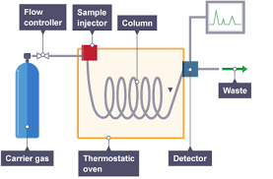
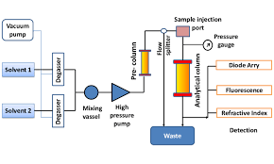
Gas chromatography
Liquid chromatography

Slide 7
PROPOSED SYSTEM
The main objective of the proposed system is to reduce the diseases that causes in our human health. However, we have solution to reduce the chemicals in fruits and vegetables which cause severe damage to our health. The farmers use the chemicals and pesticides to get more profit. So we develop an IoT based chemical detection system to monitor the chemicals present in the fruits and vegetables.
Advantages
High efficiency.
Reduces the issues occurred while using chemical added food items.
Gives actual data to the user.
Reduces human effort.

Slide 8

BLOCK DIAGRAM
PC
GAS sensor
Arduino 2560
Microcontroller
Ph sensor
BLCD
DC Motor
Fruit/Vegetable

Slide 9
Steps:
Here, IoT based Arduino 2560 Microcontroller is used, which can drive by 5V DC supply. A ph sensor, gas sensor, motor, buzzer and pc are connected with the microcontroller. The organic and inorganic samples of Mango, tomato and grapes are taken for the analysis.
Samples of mango, tomato and grapes, which is inorganic was taken and cleaned it by using pure water with the help of a motor.
After cleaning, the obtained water is used for the detection of chemicals in the samples.
In the case of tomato and grapes, the ph sensor is used to detect the ph value of the water after cleaning.

Slide 10
Steps:
If the water is pure as it is in the beginning, then the ph value will be 7, otherwise the value will be less than 7 or greater than 7, which indicates the taken sample contains chemical content in its skin.
In the case of mango, we can use ph sensor and gas sensor together. ph sensor works like the same.
The gas sensor is used to detect the gas that is produced when the chemical is dissolved in the water.
Usually, calcium carbide is applied in mangoes to artificially ripen it. once calcium carbide is dissolved in water, acetylene gas is produced.
It can be detected using the gas sensor. When the gas is detected, the buzzer will be blown.
Then the result of the analysis will be stored in the pc and we can further analyse it in future.

Slide 11
Requirements
Arduino 2560 Microcontroller
Hardware
Ph Sensor
Gas Sensor
Requirements
LCD Display
Motor

Slide 12
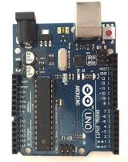
Arduino 2560 Microcontroller
Arduino is a prototype platform based on an easy-to-use hardware and software. It consists of a circuit board, which can be programed and a ready-made software called Arduino IDE, which is used to write and upload the computer code to the physical board.

Slide 13
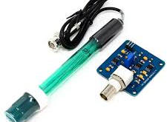
pH Sensor
pH is the numeric representation of gram-equivalent per liter of hydrogen ion concentration in any solution. It varies between 0 to14. It is the logarithmic measurement of moles of hydrogen ions per liter of solution. The solutions having pH value between 0 to 7 are acidic solutions with large concentration of hydrogen ions whereas solutions having pH value between 8 to 14 are basic solutions with small hydrogen concentration. The solutions having pH value of 7 are neutral solutions. Measuring the pH gives the measure of alkalinity or acidity of a solution.

Slide 14

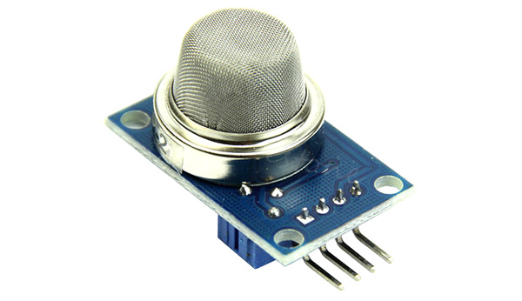
GAS
sensor
A gas sensor is a device which detects the presence or concentration of gases in the atmosphere. Based on the concentration of the gas the sensor produces a corresponding potential difference by changing the resistance of the material inside the sensor, which can be measured as output voltage. Based on this voltage value the type and concentration of the gas can be estimated. The type of gas the sensor could detect depends on the sensing material present inside the sensor.

Slide 15
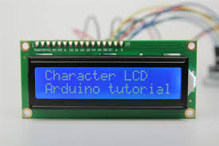
LCD display
A 16x2 LCD display is very basic module and is very commonly used in various devices and circuits. A 16x2 LCD means it can display 16 characters per line and there are 2 such lines. In this LCD each character is displayed in 5x7 pixel matrix.

Slide 16
Requirements
Operating System:Windows 7
Software
Front End:Arduino IDE
Server/Database:Thingspeak
Requirements

Slide 17
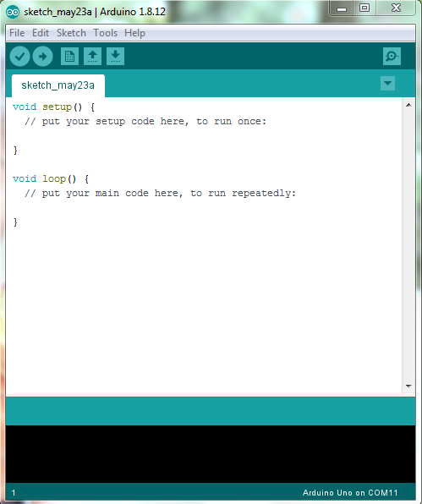
Arduino IDE
Arduino is an open-source electronics platform based on easy-to-use hardware and software. The Arduino Integrated Development Environment (IDE) is a cross-platform application that is written in functions from C and C++. It is used to write and upload programs to Arduino compatible boards, but also, with the help of 3rd party cores, other vendor development boards.

Slide 18
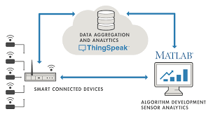

Thingspeak
ThingSpeak is an IoT analytics platform service that allows you to aggregate, visualize and analyze live data streams in the cloud. ThingSpeak provides instant visualizations of data posted by your devices to ThingSpeak.
With the ability to execute MATLAB code in ThingSpeak we can perform online analysis and processing of the data as it comes in. ThingSpeak is often used for prototyping and proof of concept IoT systems that require analytics.
.

Slide 19
Advantages
Visualize your sensor data in real-time.
Run IoT analytics automatically based on schedules or events.
Easily configure devices to send data to ThingSpeak using popular IoT protocols.
Prototype and build IoT systems without setting up servers or developing web software.

Slide 20
Future enhancement
The present work can be extended in several ways and some of them are given below:
We can use biosensors for detecting chemicals with 100% accuracy.
Also, we can add sensors like temperature and humidity sensor, variations of gas sensors to detect the freshness of the sample.
By using Data mining and Machine Learning, we can analyses various data and predict the chemical used in each sample.
For the better system, we can add Artificial Intelligence with the system, and it gives more efficient and powerful results.

Slide 21
CONCLUSION
This project (IoT based chemical detection in fruits and vegetables) is focused on securing the human health from highly toxicated fruits and vegetables. It can be used to find out the organic fruit/vegetable. The system consists of a ph sensor, a gas sensor to detect the content of the chemicals. The whole system works based on an Arduino 2560 Microcontroller. The result is stored in the Thingspeak platform, an online IoT analytical tool, which acts as a server or database.

Slide 22
Thank You

